Slide 1
Relational Database Model

Slide 2
Syallabus
Structure of RDBMS and Terminology
Database Schema and Schema Diagram
Keys: Super, Candidates, Primary, Foreign, Composite etc. and Relationship;
Introduction to Relational Algebra
Relational Algebra Operations: Select, Project, Cartesian Product, Union, Set Difference, Natural Join, Outer Join

Slide 3
Introduction to Relational Model
The relational model is the theoretical basis of relational databases.
The relational model of data is based on the concept or theory of relations.
A “Relation” is a mathematical concept based on the ideas of sets.
The Relational Model was proposed by E. F. Codd for IBM in 1970 to model data in the form of relations or tables.

Slide 4
What is Relational Model
Relational Model represents how data is stored in Relational Databases. A relational database stores data in the form of relations (tables).
After designing the conceptual model of Database using ER diagram, we need to convert the conceptual model in the relational model which can be implemented using any RDBMS applications.
RDBMS Applications: Oracle, SQL , MySQL etc.

Slide 5
What is RDBMS?
RDBMS stands for Relational Database Management System. RDBMS is the basis for SQL, and for all modern database systems like MSSQL Server, IBM DB2, Oracle, MySQL, and Microsoft Access.
A Relational database management system (RDBMS) is a database management system (DBMS) that is based on the relational model as introduced by E. F. Codd.
Current popular RDBMS include:
DB2 & Informix Dynamic Server – from IBM
Oracle & Rdb – from Oracle
SQL Server & MS Access – from Microsoft

Slide 6
RDBMS (Cont..)
A relational database refers to a database that stores data in a structured format, using rows and columns. This makes it easy to locate and access specific values within the database. It is "relational" because the values within each table are related to each other. Tables may also be related to other tables. The relational structure makes it possible to run queries across multiple tables at once.
While a relational database describes the type of database an RDMBS manages, the RDBMS refers to the database program itself. It is the software that executes queries on the data, including adding, updating, and searching for values. An RDBMS may also provide a visual representation of the data. For example, it may display data in a tables like a spreadsheet, allowing you to view and even edit individual values in the table. Some RDMBS programs allow you to create forms that can streamline entering, editing, and deleting data.

Slide 7
RDBMS (Cont.)
Most well known DBMS applications fall into the RDBMS category. Examples include Oracle Database, MySQL, Microsoft SQL Server, and IBM DB2. Some of these programs support non-relational databases, but they are primarily used for relational database management.
Examples of non-relational databases include Apache HBase, IBM Domino, and Oracle NoSQL Database. These type of databases are managed by other DMBS programs that support NoSQL, which do not fall into the RDBMS category.

Slide 8
Relational Model Concept
Relational Model can be represented as a table with columns and rows.
Each row is known as a tuple.
Each table of the column has a name or attribute.
Students
Roll No. | Name | Phone No.
1 | Ajay | 9841984984
2 | Raj | 9841984356
3 | Vijay | 9801025469
4 | Aman | 9845612385

Slide 9
Relational Model Terminology
Relation: A relation is a table with columns and rows.
Attribute: An attribute is a named column of a relation.
Domain: A domain is the set of allowable values for one or more attributes.
Tuple: A tuple is a row of a relation.
Relation Schema: A relation schema represents the name of the relation with its attributes.
Relation Instance (State): Relation instance is a finite set of tuples. Relation instances never have duplicate tuples.
Students
Roll No. | Name | Phone No.
1 | Ajay | 9841984984
2 | Raj | 9841984356
3 | Vijay | 9801025469
4 | Aman | 9845612385

Slide 10
Relational Model Terminology (Cont..)
Degree: The total number of columns or attributes in the relation
Cardinality: Total number of rows present in the table.
Relation Key: Every row has one or multiple attributes, that can uniquely identify the row in the relation, which is called relation key (Primary key).
Students
Roll No. | Name | Phone No.
1 | Ajay | 9841984984
2 | Raj | 9841984356
3 | Vijay | 9801025469
4 | Aman | 9845612385

Slide 11
Relational Model Terminology (Cont..)
Table / Relation
Attribute/Column
Students
Primary Key: Roll No
Roll No. | Name | Phone No.
1 | Ajay | 9841984984
2 | Raj | 9841984356
3 | Vijay | 9801025469
4 | Aman | 9845612385
Tuple/Row
Cardinality (no. of rows) = 4
Domain (Eg: Interger 0-9)
Tuple variable
Degree (no. of columns) =3
Relation Schema: Students (Roll_No, Name, Phone_No)

Slide 12
Properties of Relational Model
Each Relation has unique name
Each tuple/Row is unique: No duplicate row
Entries in any column have the same domain.
Each attribute/column has a unique name.
Order of the columns or rows is irrelevant i.e relations are unordered.
Each cell of relation contains exactly one value i.e attribute values are required to be atomic.
Students
Roll No. | Name | Phone No.
1 | Ajay | 9841984984
2 | Raj | 9841984356
3 | Vijay | 9801025469
4 | Aman | 9845612385

Slide 13
Alternative Terminology for Relational Model
Formal terms | Alternative 1 | Alternative 2
Relation | Table | File
Tuple | Row | Record
Attribute | Column | Field

Slide 14
Keys in DBMS
KEYS in DBMS is an attribute or set of attributes which helps you to identify a row(tuple) in a relation(table). They allow you to find the relation between two tables. Keys help you uniquely identify a row in a table by a combination of one or more columns in that table. Key is also helpful for finding unique record or row from the table. Database key is also helpful for finding unique record or row from the table.

Slide 15
Example of Keys
Employee ID | FirstName | LastName
11 | Andrew | Johnson
22 | Tom | Wood
33 | Andrew | Hale
In the above-given example, employee ID is a primary key because it uniquely identifies an employee record. In this table, no other employee can have the same employee ID.

Slide 16
Requirement of Key
Keys help you to identify any row of data in a table. In a real-world application, a table could contain thousands of records. Moreover, the records could be duplicated. Keys ensure that you can uniquely identify a table record despite these challenges.
Allows you to establish a relationship between and identify the relation between tables
Help you to enforce identity and integrity in the relationship.

Slide 17
Types of Keys
There are mainly seven different types of Keys in DBMS and each key has it’s different functionality:
Super Key - A super key is a set of one of more columns (attributes) to uniquely identify rows in a table.
Primary Key - A primary is a column or set of columns in a table that uniquely identifies tuples (rows) in that table.
Candidate Key - A super key with no redundant attribute is known as candidate key
Alternate Key - Out of all candidate keys, only one gets selected as primary key, remaining keys are known as alternate or secondary keys.

Slide 18
Types of Keys (Cont..)
Foreign Key - It is a column that creates a relationship between two tables. The purpose of Foreign keys is to maintain data integrity and allow navigation between two different instances of an entity. They act as a cross-reference between tables.
Compound Key - has two or more attributes that allow you to uniquely recognize a specific record. It is possible that each column may not be unique by itself within the database.
Composite Key - A key that consists of more than one attribute to uniquely identify rows (also known as records & tuples) in a table is called composite key.
Surrogate Key - An artificial key which aims to uniquely identify each record is called a surrogate key. These kind of key are unique because they are created when you don't have any natural primary key.

Slide 19
Super Key
A superkey is a group of single or multiple keys which identifies rows in a table. A Super key may have additional attributes that are not needed for unique identification.
In the above-given example, EmpSSN and EmpNum name are superkeys.
EmpSSN | EmpNum | Empname
9812345098 | AB05 | Shown
9876512345 | AB06 | Roslyn
199937890 | AB07 | James

Slide 20
Primary Key
PRIMARY KEY is a column in a table that uniquely identify every row in that table. The Primary Key can't be a duplicate meaning the same value can't appear more than once in the table. A table cannot have more than one primary key.
Rules for defining Primary key:
Two rows can't have the same primary key value
It must for every row to have a primary key value.
The primary key field cannot be null.
The value in a primary key column can never be modified or updated if any foreign key refers to that primary key.

Slide 21
Example: Primary Key
StudID | Roll No | First Name | LastName | Email
1 | 11 | Tom | Price | abc@gmail.com
2 | 12 | Nick | Wright | xyz@gmail.com
3 | 13 | Dana | Natan | mno@yahoo.com
Here, StudID is considered as Primary Key.

Slide 22
Candidate Key
CANDIDATE KEY is a set of attributes that uniquely identify tuples in a table. Candidate Key is a super key with no repeated attributes. The Primary key should be selected from the candidate keys. Every table must have at least a single candidate key. A table can have multiple candidate keys but only a single primary key.
Properties of Candidate key:
It must contain unique values
Candidate key may have multiple attributes
Must not contain null values
It should contain minimum fields to ensure uniqueness
Uniquely identify each record in a table

Slide 23
Example: Candidate Key
Example: In the given table Stud ID, Roll No, and email are candidate keys which help us to uniquely identify the student record in the table.
StudID | Roll No | First Name | LastName | Email
1 | 11 | Tom | Price | abc@gmail.com
2 | 12 | Nick | Wright | xyz@gmail.com
3 | 13 | Dana | Natan | mno@yahoo.com
In the given table Stud ID, Roll No, and email are candidate keys which help us to uniquely identify the student record in the table.

Slide 24
Alternate Key
ALTERNATE KEYS is a column or group of columns in a table that uniquely identify every row in that table. A table can have multiple choices for a primary key but only one can be set as the primary key. All the keys which are not primary key are called an Alternate Key.
In this table, StudID, Roll No, Email are qualified to become a primary key. But since StudID is the primary key, Roll No, Email becomes the alternative key.
StudID | Roll No | First Name | LastName | Email
1 | 11 | Tom | Price | abc@gmail.com
2 | 12 | Nick | Wright | xyz@gmail.com
3 | 13 | Dana | Natan | mno@yahoo.com

Slide 25
Foreign Key
FOREIGN KEY is a column that creates a relationship between two tables. The purpose of Foreign keys is to maintain data integrity and allow navigation between two different instances of an entity. It acts as a cross-reference between two tables as it references the primary key of another table.

Slide 26
Example: Foreign Key
We have 2 table, teacher and department in a school. However, there is no way to see which teacher work in which department.
Teacher ID | Fname | Lname
B002 | David | Warner
B017 | Sara | Joseph
B009 | Mike | Brunton
DeptCode | DeptName
001 | Science
002 | English
005 | Computer
Teacher ID | DeptCode | Fname | Lname
B002 | 002 | David | Warner
B017 | 002 | Sara | Joseph
B009 | 001 | Mike | Brunton
Adding the foreign key as Deptcode to the teacher table, we can create a relationship between the two tables. This concept is also known as Referential Integrity.

Slide 27
Compound Key
COMPOUND KEY has two or more attributes that allow you to uniquely recognize a specific record. It is possible that each column may not be unique by itself within the database. However, when combined with the other column or columns the combination of composite keys become unique. The purpose of the compound key in database is to uniquely identify each record in the table.
OrderNo | PorductID | Product Name | Quantity
B005 | JAP102459 | Mouse | 5
B005 | DKT321573 | USB | 10
B005 | OMG446789 | LCD Monitor | 20
B004 | DKT321573 | USB | 15
B002 | OMG446789 | Laser Printer | 3
In this example, OrderNo and ProductID can't be a primary key as it does not uniquely identify a record. However, a compound key of Order ID and Product ID could be used as it uniquely identified each record.

Slide 28
Composite Key
COMPOSITE KEY is a combination of two or more columns that uniquely identify rows in a table. The combination of columns guarantees uniqueness, though individually uniqueness is not guaranteed. Hence, they are combined to uniquely identify records in a table.
The difference between compound and the composite key is that any part of the compound key can be a foreign key, but the composite key may or maybe not a part of the foreign key.

Slide 29
Surrogate Key
SURROGATE KEYS is an artificial key which aims to uniquely identify each record. This kind of partial key in dbms is unique because it is created when you don't have any natural primary key. They do not lend any meaning to the data in the table. Surrogate key is usually an integer. A surrogate key is a value generated right before the record is inserted into a table.
Fname | Lastname | Start Time | End Time
Anne | Smith | 09:00 | 18:00
Jack | Francis | 08:00 | 17:00
Anna | McLean | 11:00 | 20:00
Shown | Willam | 14:00 | 23:00
Above, given example, shown shift timings of the different employee. In this example, a surrogate key is needed to uniquely identify each employee.

Slide 30
Surrogate Key
Surrogate keys in sql are allowed when
No property has the parameter of the primary key.
In the table when the primary key is too big or complicated.

Slide 31
Difference Between Primary Key & Foreign Key
Primary Key | Foreign Key
Helps you to uniquely identify a record in the table. | It is a field in the table that is the primary key of another table.
Primary Key never accept null values. | A foreign key may accept multiple null values.
Primary key is a clustered index and data in the DBMS table are physically organized in the sequence of the clustered index. | A foreign key cannot automatically create an index, clustered or non-clustered. However, you can manually create an index on the foreign key.
You can have the single Primary key in a table. | You can have multiple foreign keys in a table.

Slide 32
Relational Model
Mathematical Structure

Slide 33
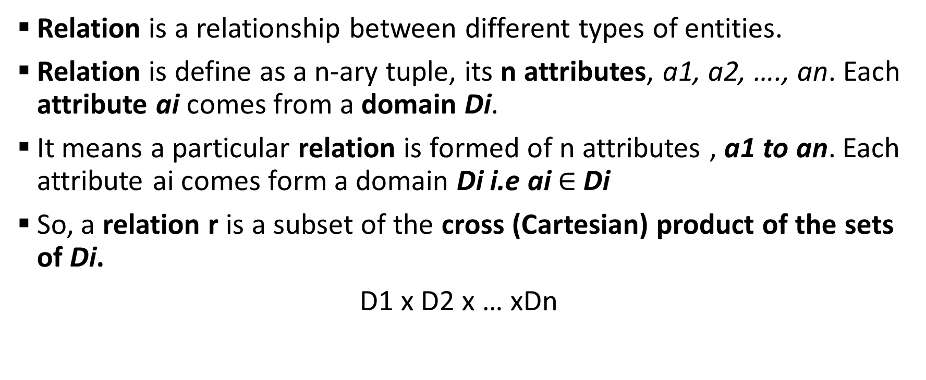
Relational Model: Mathematical Structure
Relation is a relationship between different types of entities.
Relation is define as a n-ary tuple, its n attributes, a1, a2, …., an. Each attribute ai comes from a domain Di.
It means a particular relation is formed of n attributes , a1 to an. Each attribute ai comes form a domain Di i.e ai $∈$ Di
So, a relation r is a subset of the cross (Cartesian) product of the sets of Di.
D1 x D2 x … xDn

Slide 34
Mathematical Relations
Suppose we have two sets D1 and D2,
where D1={2,4}
and D2={1,3,5}
The cartesian product of these two sets, written as D1x D2, is the set of all ordered pairs such that the first element is a member of set D1 and second element is a member of set D2.
D1 x D2 = {(2,1),(2,3),(2,5),(4,1),(4,3),(4,5)}
So, r = {(2,1), (4,1)} is a relation over D1 x D2

Slide 35
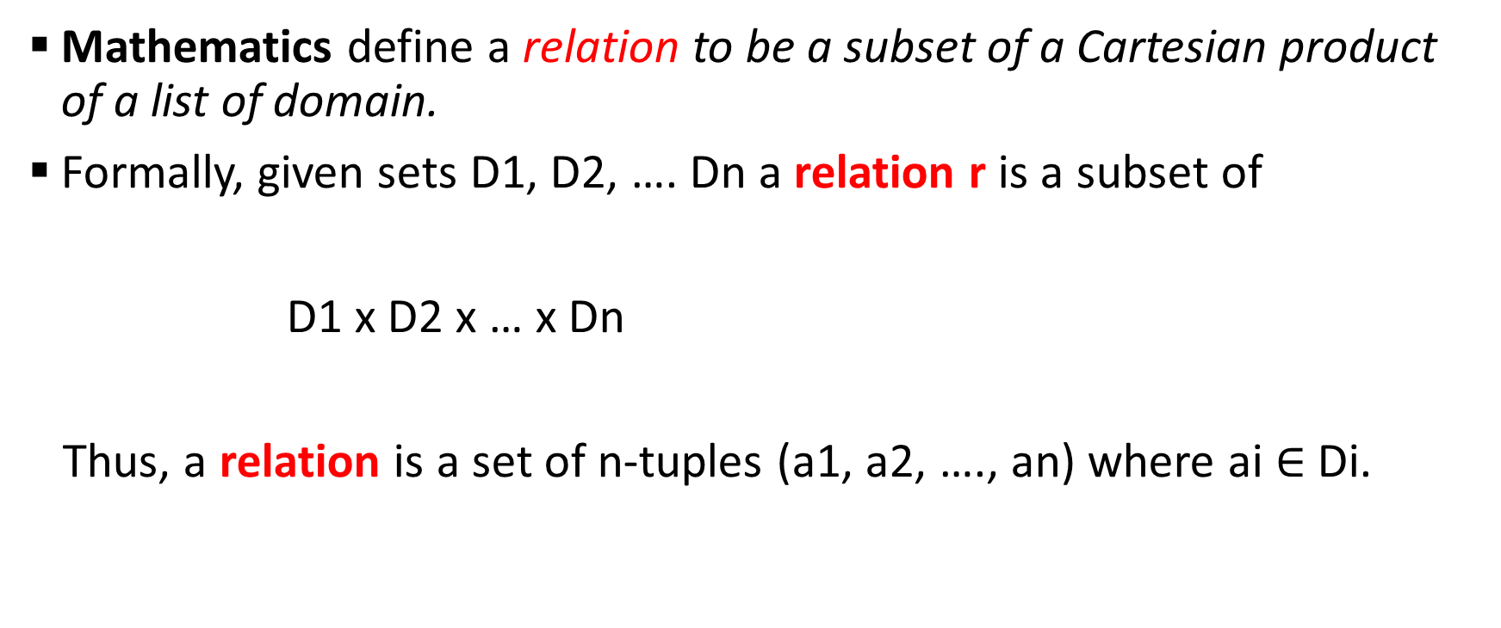
Relational Model Mathematical Definition
Mathematics define a relation to be a subset of a Cartesian product of a list of domain.
Formally, given sets D1, D2, …. Dn a relation r is a subset of
D1 x D2 x … x Dn
Thus, a relation is a set of n-tuples (a1, a2, …., an) where ai $∈$ Di.

Slide 36
Example: Relational Model
For example: if a1: customer-name = {Jones, Smith, Curry, Lindsay}
a2: customer-street= {Main, North, Park}
a3: customer-city = {Harrison, Rye, Pittsfield}
Then r = {(Jones, Main, Harrison),
(Smith, North, Rye),
(Curry, North, Rye),
(Lindsay, Park, Pittsfield)}
r is a relation over customer-name x customer-street x customer-city
1st tuple
2st tuple
3st tuple
4st tuple

Slide 37
Relations are Unordered
In relational model relation is depicted as table
In relation (or table),
Order of tuples is irrelevant (tuples may be stored in an arbitrary order)
i.e. Relation are unordered
r = {(Jones, Main, Harrison),
(Smith, North, Rye),
(Curry, North, Rye),
(Lindsay, Park, Pittsfield)}
Customer-name | Customer-street | Customer-city
Jones | Main | Harrison
Smith | North | Rye
Curry | North | Rye
Lindsay | Park | Pittsfield

Slide 38
Attribute Types
Name: Each attribute of a relation has a name
Domain: The set of allowed values for each attribute is called the domain of the attribute
Roll_No: Numeric (of 10 digit)
Name: Character (of 1-30)
DOB: Date ddmmyyyy
Atomic: Attribute values are required to be atomic, that is, indivisible (atomic means cannot be subdivided any further)
E.g. multivalued attribute values are not atomic
E.g. composite attribute values are not atomic
NULL: The special value null is a member of every domain
null value can be used for unknown values or not applicable (NA) values
The null value cause complications in the definition of may operations

Slide 39
Relation Schema
Schema means that this is the description of the relation
A₁, A₂, …, A_{n} are attributes
R= (A₁, A₂, …, A_{n} ) is a relation schema
E.g. Customer-schema = (customer-name, customer-street, customer-city)
A relation is defined over a schema i.e r(R)
r(R) is a relation r on the relation schema R
E.g customer (Customer-schema)

Slide 40
Relation Instance
The current values (relation instance) of a relation are specified by a table
r = {(Jones, Main, Harrison),
(Smith, North, Rye),
(Curry, North, Rye),
(Lindsay, Park, Pittsfield)}
An element t of r is a tuple, represented by a row in a table
Attribute Ai represents columns in a table
“Database is a multiple interrelated relations”
1st tuple
2st tuple
3st tuple
4st tuple

Slide 41
Relational Model Terminology (Cont..)
Table / Relation
Attribute/Column
Students
Primary Key: Roll No
Roll No. | Name | Phone No.
1 | Ajay | 9841984984
2 | Raj | 9841984356
3 | Vijay | 9801025469
4 | Aman | 9845612385
Tuple/Row
Cardinality (no. of rows) = 4
Domain (Eg: Interger 0-9)
Tuple variable
Degree (no. of columns) =3
Relation Schema: Students (Roll_No, Name, Phone_No)

Slide 42
Relational Query Language

Slide 43
Relation Query Languages
Relational database systems are expected be equipped with a query language that assist its users to query the database instances.
Query Language is a Language in which user requests information from the database. Eg: SQL
Query = “Retrival Program”
Two types of Query Language:
Procedural Query Language
Non-Procedural Query Language
Query Language
Procedural Language
Non-Procedural Language

Slide 44
Procedural vs. Non-Procedural
Procedural Query Language:
In Procedural query language, user instructs the system to perform a series of operations to produce the desired results.
User tells what data to be retrived from database and how to retrieve it.
Non-procedural (or Declarative) Query Language:
In Non-procedural query language, user instructs the system to produce the desired result without telling the step by step process.
User tells what data to be retrieved from database but doesn’t tell how to retrieve it.

Slide 45
Two “Pure” Query Languages
Two “Pure” Query languages or Two Mathematical Query Language:
Relational Algebra
Relational Calculus
Tuple Relational Calculus
Domain Relational Calculus

Slide 46
Relation Algebra vs. Relational Calculus
Relational Algebra:
Relational algebra is a procedural query language
It is more operational, very useful for representing execution plan.
Procedural: What data is required and How to get those data.
Relation Calculus:
Tuple Relational Calculus
Domain Relational Calculus
Relation calculus is a non-procedural query language
It is non-operational or declarative
Non-Procedural: What data they want without specifying how to get those data.

Slide 47
Query Language
Procedural Language
Non-Procedural Language
Relational Algebra
Relational Calculus
SQL

Slide 48
Relational Algebra, Calculus, RDBMS & SQL:
Relational Model is a theoretical concept.
RDBMS is a practical implementation of relational model.
SQL (Structured Query Language) is used to write query on RDBMS
Relational algebra and calculas are the Mathematical system or Query language used on relational model.
Understanding Relational Algebra and Calculus is key to understand SQL Query Language.
SQL is a practical implementation of relational algebra and calculus.
Relational Model | RDBMS
Relational Algebra, Relational Calculus | SQL
Algorithm | Code
Conceptual | Reality
Theoretical | Practical

Slide 49
Relational Algebra

Slide 50
Relational Algebra
Relational Algebra is a procedural query language which takes a relation as on input an generates a relation as an output
Relational Algebra is a language for expressing relational database queries.
It uses operators to perform queries. An operator can be either unary or binary.
Types of operators in relational algebra:
Basic/Fundamental Operators
Additional/Drived Operators
Relational algebra operations work on one or more relations to define another relation without changing the original relations.
Relation algebra operations are performed recursively on a relation

Slide 51
Relational Algebra (Cont..)
In relational algebra, input is a relation (table from which data has to be accessed) and output is also a relation (a temporary table holding the data asked for by the user).
Relational algebra is performed recursively on a relation an intermediate results are also considered relations. i.e Relation Algebra works on the whole table at once, so we do not have to use loops etc to iterate over all the rows (tuples) of data one by one.
All we have to do is to specify the table name from which we need the data, and in a single line of command, relational algebra will transverse the entire given table to fetch data for you.

Slide 52
ID | Name | Age
1 | Akon | 17
2 | Bkon | 19
3 | Ckon | 15
4 | Dkon | 13
We can use Relation Algebra to fetch data from this table (relation)
Select Name of students with age less than 17
Name
Ckon
Dkon
The output of query is also in form of a table(relation), with results in different columns

Slide 53



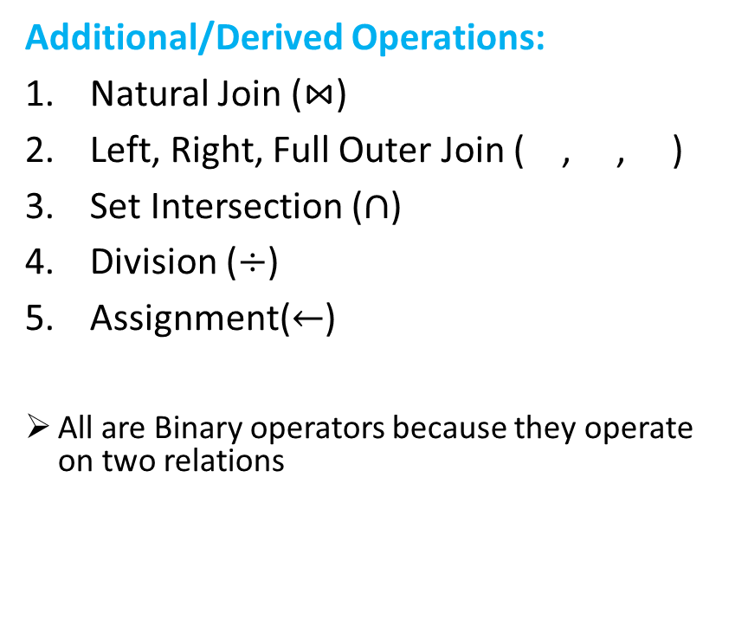
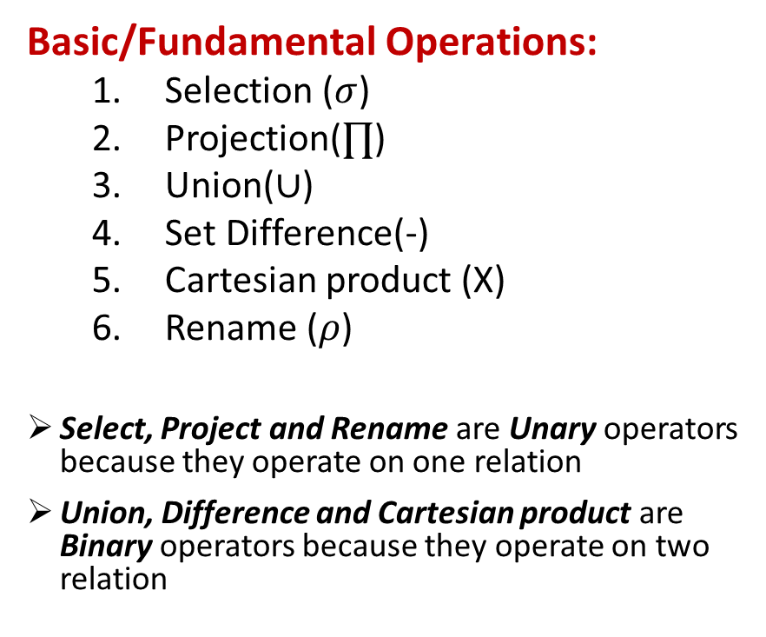
Relation Algebra Operations
Basic/Fundamental Operations:
Selection ($σ$)
Projection($∏$)
Union($∪$)
Set Difference(-)
Cartesian product (X)
Rename ($ρ$)
Select, Project and Rename are Unary operators because they operate on one relation
Union, Difference and Cartesian product are Binary operators because they operate on two relation
Additional/Derived Operations:
Natural Join ($\text{⋈}$)
Left, Right, Full Outer Join ( , , )
Set Intersection ($∩$)
Division ($÷$)
Assignment($←$)
All are Binary operators because they operate on two relations

Slide 54
Selection Operator In Relational Algebra

Slide 55
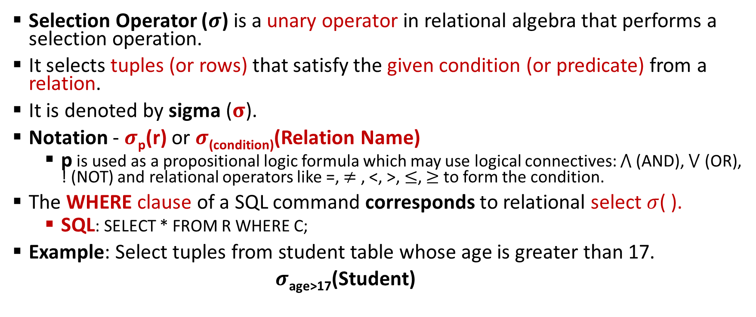

Selection ($σ$)Operator
Selection Operator ($σ$) is a unary operator in relational algebra that performs a selection operation.
It selects tuples (or rows) that satisfy the given condition (or predicate) from a relation.
It is denoted by sigma ($σ$).
Notation - $σ$_{p}(r) or $σ$_{(condition)}(Relation Name)
p is used as a propositional logic formula which may use logical connectives: $⋀$(AND), $⋁$ (OR), ! (NOT) and relational operators like =, $≠$ , <, >, $≤$, $≥$ to form the condition.
The WHERE clause of a SQL command corresponds to relational select $σ$( ).
SQL: SELECT * FROM R WHERE C;
Example: Select tuples from student table whose age is greater than 17.
$σ$_{age>17}(Student)

Slide 56

Student
roll_no | name | age | address
1 | A | 20 | Bhopal
2 | B | 17 | Mumbai
3 | C | 16 | Mumbai
4 | D | 19 | Delhi
5 | E | 18 | Delhi
Query 1: Select student whose roll no. is 2
$σ$_{roll_no=2}(Student)
roll_no | name | age | address
2 | B | 17 | Mumbai
Note: In Selection operator, schema of resulting relation is identical to schema of input relation

Slide 57

Student
roll_no | name | age | address
1 | A | 20 | Bhopal
2 | B | 17 | Mumbai
3 | C | 16 | Mumbai
4 | D | 19 | Delhi
5 | E | 18 | Delhi
Query 2: Select student whose name is D
$σ$_{name=“D”}(Student)
roll_no | name | age | address
4 | D | 19 | Delhi

Slide 58

Student
roll_no | name | age | address
1 | A | 20 | Bhopal
2 | B | 17 | Mumbai
3 | C | 16 | Mumbai
4 | D | 19 | Delhi
5 | E | 18 | Delhi
Query 3: Select student whose age is greater than 17
$σ$_{age>17} (Student)
roll_no | name | age | address
1 | A | 20 | Bhopal
4 | D | 19 | Delhi
5 | E | 18 | Delhi

Slide 59

Student
roll_no | name | age | address
1 | A | 20 | Bhopal
2 | B | 17 | Mumbai
3 | C | 16 | Mumbai
4 | D | 19 | Delhi
5 | E | 18 | Delhi
Query 4: Select student whose age is greater than 17 and who lives in Delhi.
$σ$_{age>17 ⋀ address = “Delhi”} (Student)
roll_no | name | age | address
4 | D | 19 | Delhi
5 | E | 18 | Delhi

Slide 60
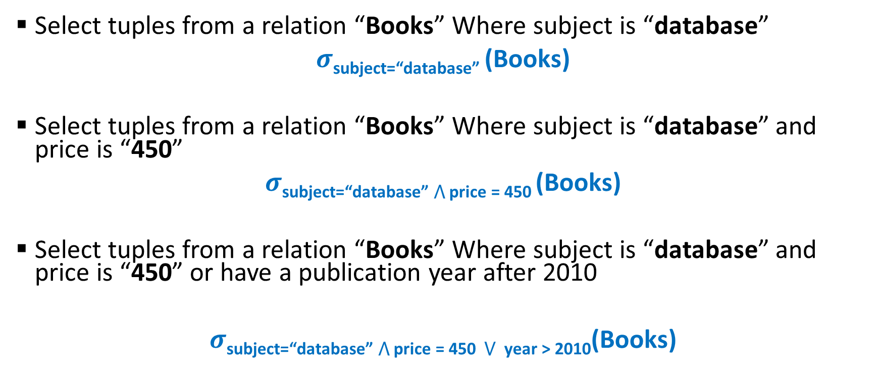
Examples
Select tuples from a relation “Books” Where subject is “database”
$σ$_{subject=“database”} (Books)
Select tuples from a relation “Books” Where subject is “database” and price is “450”
$σ$subject=“database” ⋀ price = 450 (Books)
Select tuples from a relation “Books” Where subject is “database” and price is “450” or have a publication year after 2010
$σ$subject=“database” ⋀ price = 450 ⋁ year > 2010(Books)

Slide 61
Projection Operator In Relational Algebra

Slide 62
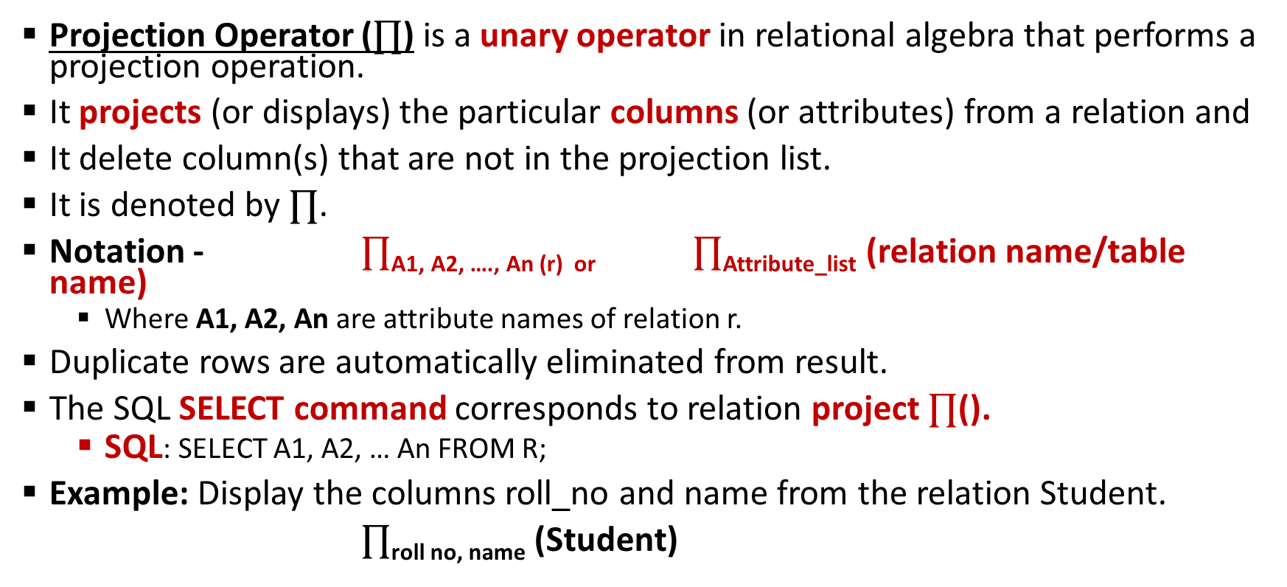

Projection ($∏$) Operator
Projection Operator ($∏$) is a unary operator in relational algebra that performs a projection operation.
It projects (or displays) the particular columns (or attributes) from a relation and
It delete column(s) that are not in the projection list.
It is denoted by $∏$.
Notation - $∏$_{A1, A2, …., An (r) or} $∏$_{Attribute_list} (relation name/table name)
Where A1, A2, An are attribute names of relation r.
Duplicate rows are automatically eliminated from result.
The SQL SELECT command corresponds to relation project $∏$().
SQL: SELECT A1, A2, … An FROM R;
Example: Display the columns roll_no and name from the relation Student.
$∏$_{roll no, name} (Student)

Slide 63

Student
roll_no | name | age | address
1 | A | 20 | Bhopal
2 | B | 17 | Mumbai
3 | C | 16 | Mumbai
4 | D | 19 | Delhi
5 | E | 18 | Delhi
6 | F | 18 | Goa
Query 1: Display (or project) the name of students in the student table
$∏$ _{name} (Student)
name
A
B
C
D
E
F

Slide 64

Student
roll_no | name | age | address
1 | A | 20 | Bhopal
2 | B | 17 | Mumbai
3 | C | 16 | Mumbai
4 | D | 19 | Delhi
5 | E | 18 | Delhi
6 | F | 18 | Goa
Query 2: Display the roll_no and name of students in the student table
$∏$ _{roll_no, name} (Student)
roll_no | name
1 | A
2 | B
3 | C
4 | D
5 | E
6 | F

Slide 65

Student
roll_no | name | age | address
1 | A | 20 | Bhopal
2 | B | 17 | Mumbai
3 | C | 16 | Mumbai
4 | D | 19 | Delhi
5 | E | 18 | Delhi
6 | F | 18 | Goa
Query 3: Display the age of students in the student table
$∏$ _{age} (Student)
age
20
17
16
19
18
Note: By default, projection removes duplicate values

Slide 66

Student
roll_no | name | age | address
1 | A | 20 | Bhopal
2 | B | 17 | Mumbai
3 | C | 16 | Mumbai
4 | D | 19 | Delhi
5 | E | 18 | Delhi
6 | F | 18 | Goa
Query 1: Display the roll_no and name of students whose age is greater than 17.
$∏$ _{roll_no,} _{name} ($σ$_{age>17} (Student) )
roll_no | name
1 | A
4 | D
5 | E
6 | F
Wrong
($σ$_{age>17} ($∏$ _{roll_no,} _{name} (Student) )

Slide 67
SET OPERATORS: UNION, SET INTERSECTION & SET DIFFERENCE

Slide 68

Set Operators in Relational Algebra
Set Operators
Union (U)
Set Intersection ($∩$)
Set Difference (-)
Fundamental Operator
Derived
Operator
Fundamental Operator

Slide 69
Set Operators
Set operators: Union, intersection and difference, binary operators as they takes two input relations
To use set operators on two relations,
The two relations must be Comapatible
Two relations are Compatible if –
Both the relations must have same number of attributes (or columns).
Corresponding attribute (or column) have the same domain (or type).
Duplicate tuples are automatically eliminated

Slide 70
Union (U) Operator
Suppose R and S are two relations. The Union operation selects all the tuples that are either in relations R or S or in both relations R & S.
It eliminates the duplicate tuples.
For a union operation to be valid, the following conditions must hold -
Two relations R and S both have same number of attributes (or columns).
Corresponding attribute (or column) have the same domain (or type).
The attributes of R and S must occur in the same order.
Duplicate tuples should be automatically removed.
Symbol: U
Notation: R U S
RA: R U S
SQL: (SELECT * FROM R)
UNION (SELECT * FROM S);
1
2
3
2
3
4
1
2
3
4
R
S
R U S

Slide 71
Example
Student
Employee
(Student) U (Employee)
Roll_no | Name
1 | A
2 | B
3 | C
4 | D
Emp_no | Name
2 | B
8 | G
9 | H
Roll_no | Name
1 | A
2 | B
3 | C
4 | D
8 | G
9 | H
Note: Union is commutative: A U B = B U A

Slide 72
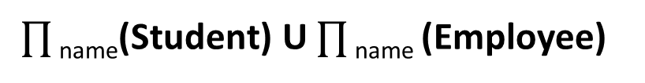
Example
Student
Employee
$∏$ _{name}(Student) U $∏$ _{name} (Employee)
Roll_no | Name
1 | A
2 | B
3 | C
4 | D
Emp_no | Name
2 | B
8 | G
9 | H
Name
A
B
C
D
G
H
Note: Union is commutative: A U B = B U A

Slide 73

Example
Find the names of the authors who have either written a book or an article or both.
$∏$ _{author}(Books) U $∏$ _{author} (Articles)

Slide 74
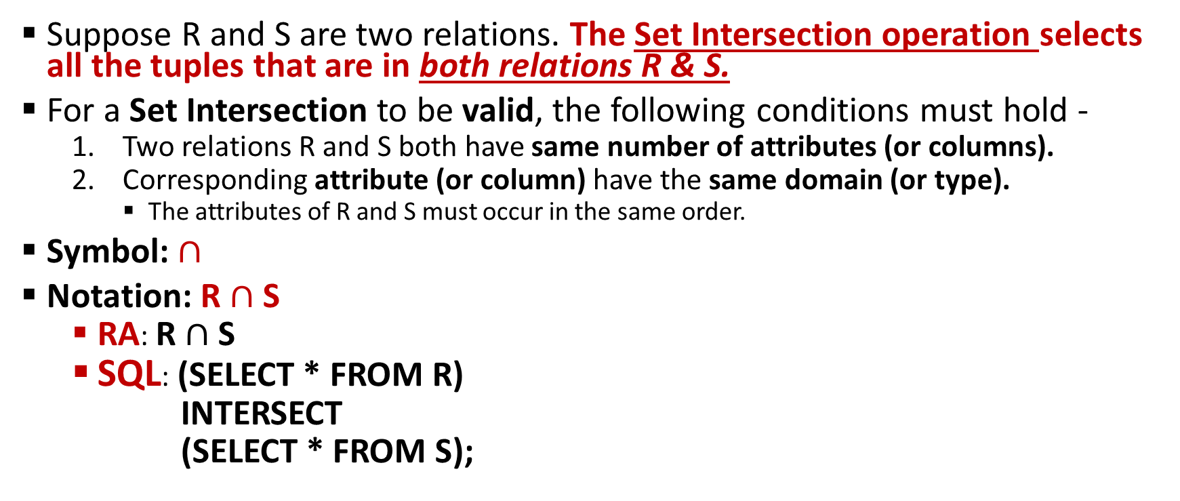


Set Intersection ($∩$) Operator
Suppose R and S are two relations. The Set Intersection operation selects all the tuples that are in both relations R & S.
For a Set Intersection to be valid, the following conditions must hold -
Two relations R and S both have same number of attributes (or columns).
Corresponding attribute (or column) have the same domain (or type).
The attributes of R and S must occur in the same order.
Symbol: $∩$
Notation: R $∩$ S
RA: R $∩$ S
SQL: (SELECT * FROM R)
INTERSECT
(SELECT * FROM S);
1
2
3
2
3
4
2
3
R
S
R $∩$ S

Slide 75
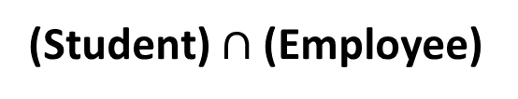
Example
Student
Employee
(Student) $∩$ (Employee)
Roll_no | Name
1 | A
2 | B
3 | C
4 | D
Emp_no | Name
2 | B
8 | G
9 | H
Roll_no | Name
2 | B
Note: Set Intersection is commutative: A $∩$ B = B $∩$ A

Slide 76
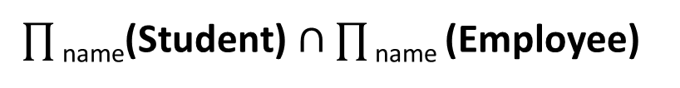
Example
Student
Employee
$∏$ _{name}(Student) $∩$ $∏$ _{name} (Employee)
Roll_no | Name
1 | A
2 | B
3 | C
4 | D
Emp_no | Name
2 | B
8 | G
9 | H
Name
B

Slide 77

Example
Find the names of the authors who have written a book and an article both.
$∏$ _{author}(Books) U $∏$ _{author} (Articles)

Slide 78
Set Difference (-) Operator
Suppose R and S are two relations. The Set Difference operation selects all the tuples that are present in first relation R but not in second relation S.
For a Set Difference to be valid, the following conditions must hold -
Two relations R and S both have same number of attributes (or columns).
Corresponding attribute (or column) have the same domain (or type).
The attributes of R and S must occur in the same order.
Symbol: -
Notation: R – S
RA: R – S
SQL: (SELECT * FROM R)
EXCEPT
(SELECT * FROM S);
1
2
3
2
3
4
1
2
3
4
R
S
R – S

Slide 79
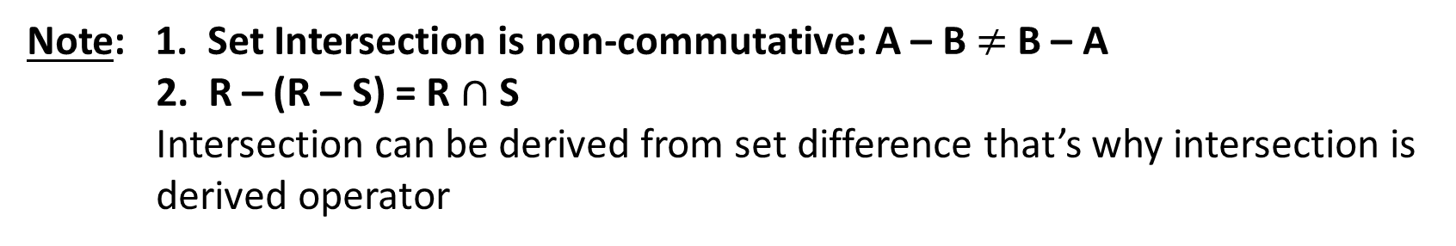
Example
Student
Employee
(Student) – (Employee)
Roll_no | Name
1 | A
2 | B
3 | C
4 | D
Emp_no | Name
2 | B
8 | G
9 | H
Roll_no | Name
1 | A
3 | C
4 | D
Note: 1. Set Intersection is non-commutative: A – B $≠$ B – A
2. R – (R – S) = R $∩$ S
Intersection can be derived from set difference that’s why intersection is derived operator

Slide 80
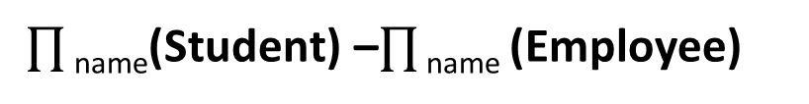
Example
Student
Employee
$∏$ _{name}(Student) –$∏$ _{name} (Employee)
Roll_no | Name
1 | A
2 | B
3 | C
4 | D
Emp_no | Name
2 | B
8 | G
9 | H
Name
A
C
D

Slide 81

Example
Find the names of the authors who have written books but not articles.
$∏$ _{author}(Books) – $∏$ _{author} (Articles)

Slide 82
CARTESIAN PRODUCT

Slide 83
Cartesian Product/Cross Product
Cartesian Product is fundamental operator in relational algebra
Cartesian Product combines information of two different relations into one.
It is also called Cross Product.
Generally, a Cartesian Product is never a meaningful operation when it is performed alone. However, it becomes meaningful when it is followed by other operations.
Generally it is followed by select operations.
Symbol: x
Notation: R1 x R2
SQL: SELECT * FROM R1 x R2

Slide 84
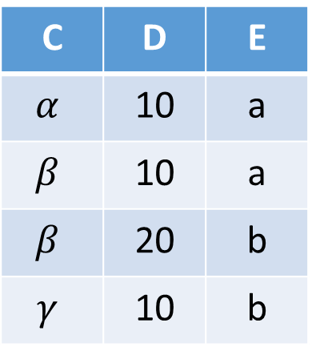
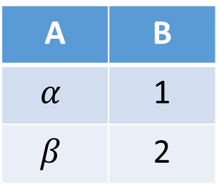
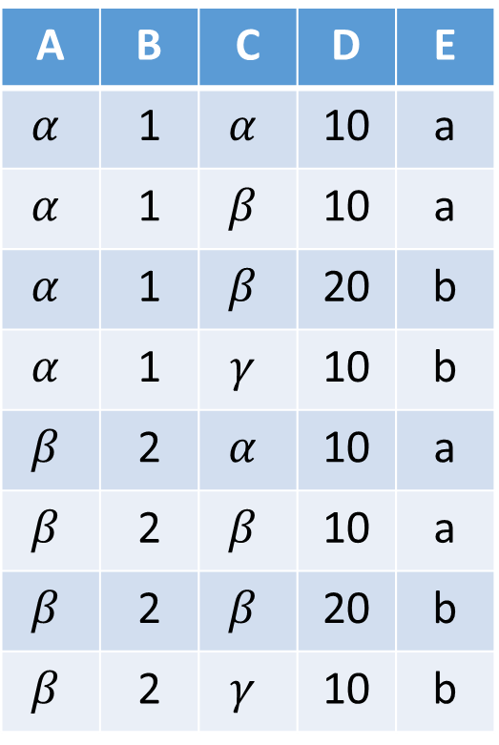
Example
R1 x R2
R1
R2
A | B | C | D | E
$$α$$ | 1 | $$α$$ | 10 | a
$$α$$ | 1 | $$β$$ | 10 | a
$$α$$ | 1 | $$β$$ | 20 | b
$$α$$ | 1 | $$γ$$ | 10 | b
$$β$$ | 2 | $$α$$ | 10 | a
$$β$$ | 2 | $$β$$ | 10 | a
$$β$$ | 2 | $$β$$ | 20 | b
$$β$$ | 2 | $$γ$$ | 10 | b
A | B
$$α$$ | 1
$$β$$ | 2
C | D | E
$$α$$ | 10 | a
$$β$$ | 10 | a
$$β$$ | 20 | b
$$γ$$ | 10 | b

Slide 85
Characteristics
If relation R1 and R2 have a & b attributes respectively, then resulting relation will have a + b attributes from both the input relations.
If relation R1 and R2 have n1 & n2 tuples respectively, then resulting relation will have n1 x n2 tuples, combining each possible pair of tuples from both the relations.
If both input relation have some attribute having same name, change the name of the attribute with the name of the relation “relation_name.attribute_name”
 | R1 R2 | R1 x R2
Attributes | a b | (a + b)
Tuples | n1 n2 | (n1 x n2)

Slide 86
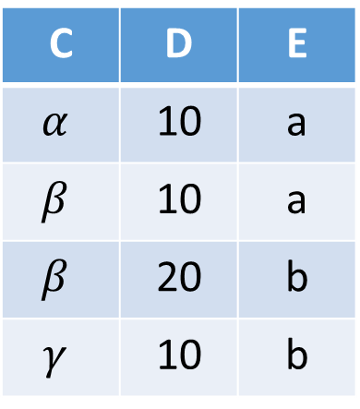
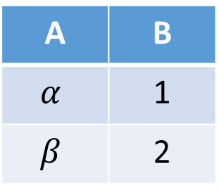
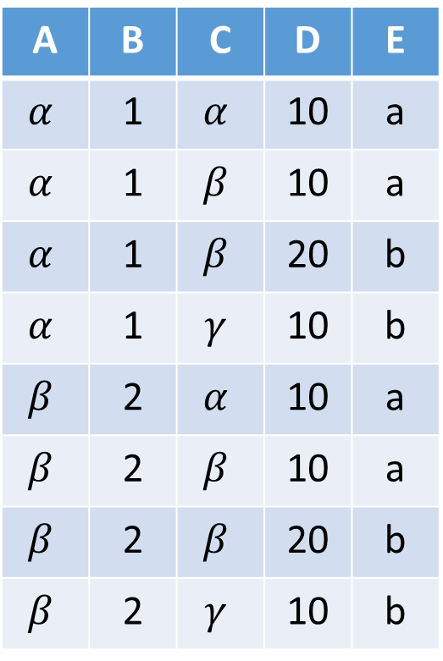
Example
R1 x R2
R1
R2
A | B | C | D | E
$$α$$ | 1 | $$α$$ | 10 | a
$$α$$ | 1 | $$β$$ | 10 | a
$$α$$ | 1 | $$β$$ | 20 | b
$$α$$ | 1 | $$γ$$ | 10 | b
$$β$$ | 2 | $$α$$ | 10 | a
$$β$$ | 2 | $$β$$ | 10 | a
$$β$$ | 2 | $$β$$ | 20 | b
$$β$$ | 2 | $$γ$$ | 10 | b
A | B
$$α$$ | 1
$$β$$ | 2
C | D | E
$$α$$ | 10 | a
$$β$$ | 10 | a
$$β$$ | 20 | b
$$γ$$ | 10 | b
R1 x R2
Resulting relation must have
2+3 = 5 attributes
2 x 4 = 8 tuples

Slide 87
Example
R1 x R2
R1
R2
A | B | C | D | E
$$α$$ | 1 | $$α$$ | 10 | a
$$α$$ | 1 | $$β$$ | 10 | a
$$α$$ | 1 | $$β$$ | 20 | b
$$α$$ | 1 | $$γ$$ | 10 | b
$$β$$ | 2 | $$α$$ | 10 | a
$$β$$ | 2 | $$β$$ | 10 | a
$$β$$ | 2 | $$β$$ | 20 | b
$$β$$ | 2 | $$γ$$ | 10 | b
A | B
$$α$$ | 1
$$β$$ | 2
C | D | E
$$α$$ | 10 | a
$$β$$ | 10 | a
$$β$$ | 20 | b
$$γ$$ | 10 | b
R1 x R2
Resulting relation must have
2+3 = 5 attributes
2 x 4 = 8 tuples

Slide 88
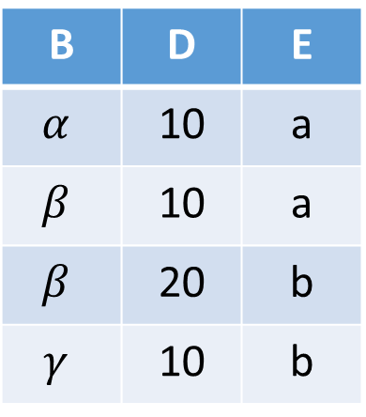

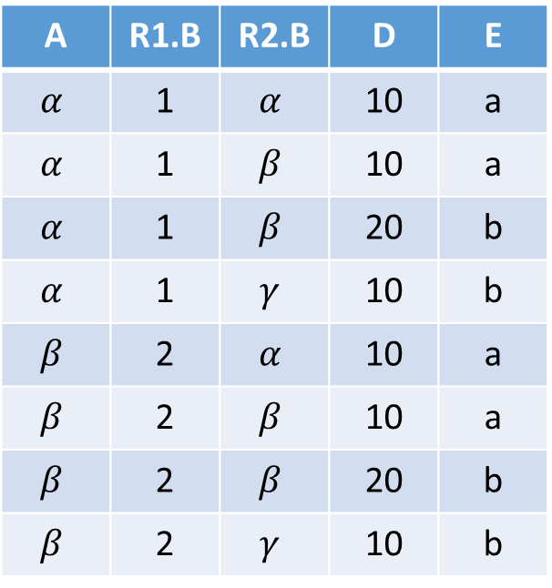
Example
If both input relation have some attribute having same name, change the name of the attribute with the name of the relation “relation_name.attribute_name”
A | R1.B | R2.B | D | E
$$α$$ | 1 | $$α$$ | 10 | a
$$α$$ | 1 | $$β$$ | 10 | a
$$α$$ | 1 | $$β$$ | 20 | b
$$α$$ | 1 | $$γ$$ | 10 | b
$$β$$ | 2 | $$α$$ | 10 | a
$$β$$ | 2 | $$β$$ | 10 | a
$$β$$ | 2 | $$β$$ | 20 | b
$$β$$ | 2 | $$γ$$ | 10 | b
R1
R2
A | B
$$α$$ | 1
$$β$$ | 2
B | D | E
$$α$$ | 10 | a
$$β$$ | 10 | a
$$β$$ | 20 | b
$$γ$$ | 10 | b
R1 x R2

Slide 89
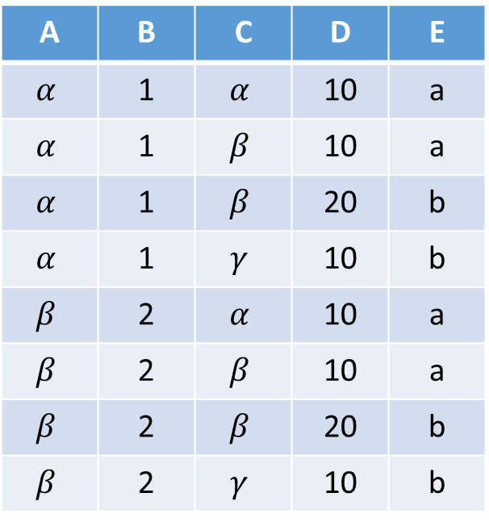

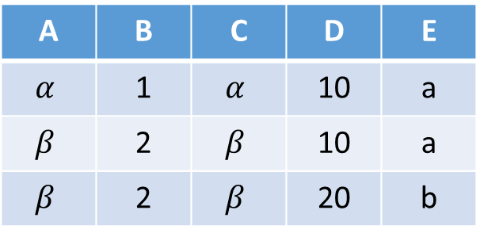
Example: Composition of Operations
Can build expressions using multiple operations
Example: $σ$_{A=C} (R1 x R2)
R1 x R2
A | B | C | D | E
$$α$$ | 1 | $$α$$ | 10 | a
$$α$$ | 1 | $$β$$ | 10 | a
$$α$$ | 1 | $$β$$ | 20 | b
$$α$$ | 1 | $$γ$$ | 10 | b
$$β$$ | 2 | $$α$$ | 10 | a
$$β$$ | 2 | $$β$$ | 10 | a
$$β$$ | 2 | $$β$$ | 20 | b
$$β$$ | 2 | $$γ$$ | 10 | b
A | B | C | D | E
$$α$$ | 1 | $$α$$ | 10 | a
$$β$$ | 2 | $$β$$ | 10 | a
$$β$$ | 2 | $$β$$ | 20 | b

Slide 90

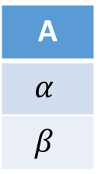
Example: Composition of Operations
Can build expressions using multiple operations
Example: $∏$_{A} ($σ$_{D=20} (R1 x R2))
R1 x R2
A | B | C | D | E
$$α$$ | 1 | $$α$$ | 10 | a
$$α$$ | 1 | $$β$$ | 10 | a
$$α$$ | 1 | $$β$$ | 20 | b
$$α$$ | 1 | $$γ$$ | 10 | b
$$β$$ | 2 | $$α$$ | 10 | a
$$β$$ | 2 | $$β$$ | 10 | a
$$β$$ | 2 | $$β$$ | 20 | b
$$β$$ | 2 | $$γ$$ | 10 | b
A
$$α$$
$$β$$

Slide 91

Example
$σ$_{author=“Korth”} (Books x Articles)
The resulting relation shows all the books and articles written by Korth.

Slide 92
RENAME OPERATOR

Slide 93
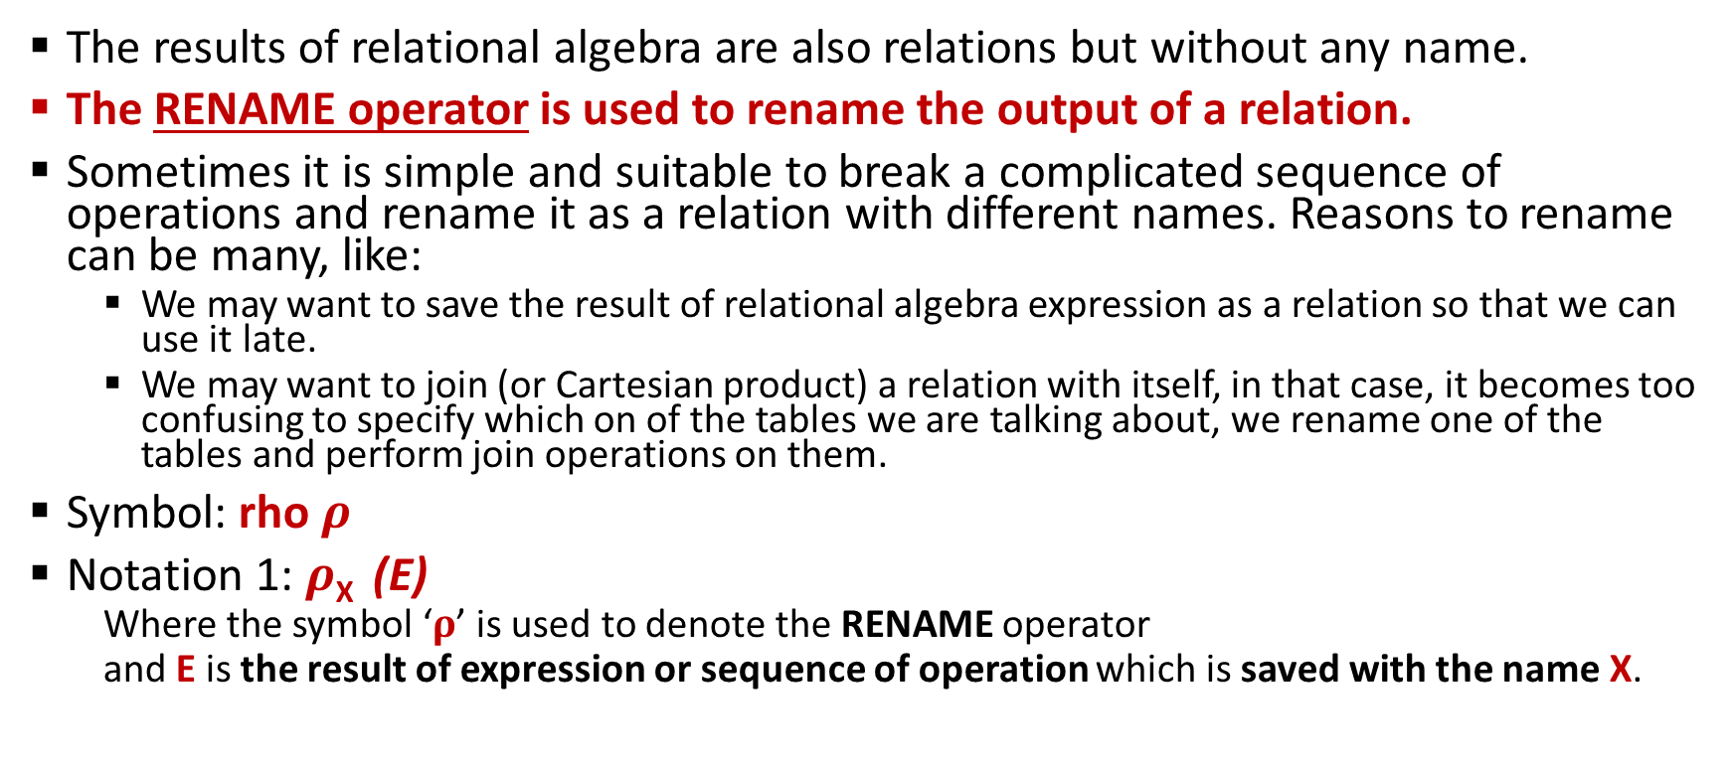
Rename Operator
The results of relational algebra are also relations but without any name.
The RENAME operator is used to rename the output of a relation.
Sometimes it is simple and suitable to break a complicated sequence of operations and rename it as a relation with different names. Reasons to rename can be many, like:
We may want to save the result of relational algebra expression as a relation so that we can use it late.
We may want to join (or Cartesian product) a relation with itself, in that case, it becomes too confusing to specify which on of the tables we are talking about, we rename one of the tables and perform join operations on them.
Symbol: rho $ρ$
Notation 1: $ρ$_{X} (E)
Where the symbol ‘$ρ$’ is used to denote the RENAME operator
and E is the result of expression or sequence of operation which is saved with the name X.

Slide 94
Rename Operator (Cont..)
SQL: Use the AS keyword in the FROM clause
(Eg: Students AS Students1 renames Students to Student1)
SELECT column_name
FROM tablename AS new_table_name
WHERE condition
SQL: Use the AS keyword in the SELECT clause to rename attributes (columns)
(Eg: RollNo AS SNo renames RollNo to SNo)
SELECT column_name AS new_column_name
FROM tablename
WHERE condition

Slide 95
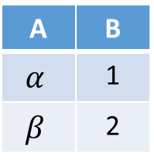
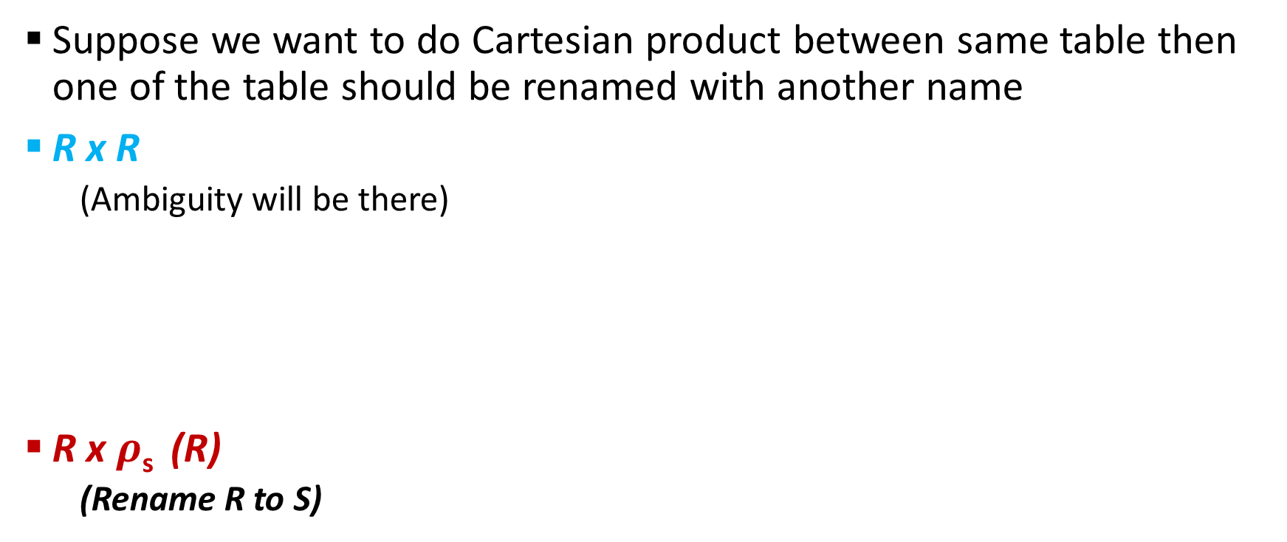

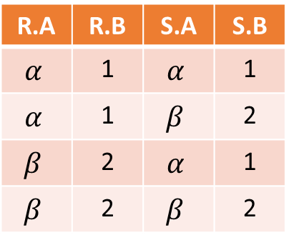
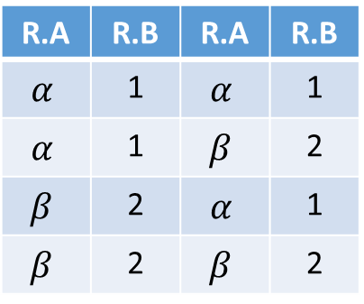
Example
Suppose we want to do Cartesian product between same table then one of the table should be renamed with another name
R x R
(Ambiguity will be there)
R x $ρ$_{s} (R)
(Rename R to S)
R x R
R.A | R.B | R.A | R.B
$$α$$ | 1 | $$α$$ | 1
$$α$$ | 1 | $$β$$ | 2
$$β$$ | 2 | $$α$$ | 1
$$β$$ | 2 | $$β$$ | 2
R
A | B
$$α$$ | 1
$$β$$ | 2
R x $ρ$_{s} (R)
R.A | R.B | S.A | S.B
$$α$$ | 1 | $$α$$ | 1
$$α$$ | 1 | $$β$$ | 2
$$β$$ | 2 | $$α$$ | 1
$$β$$ | 2 | $$β$$ | 2

Slide 96
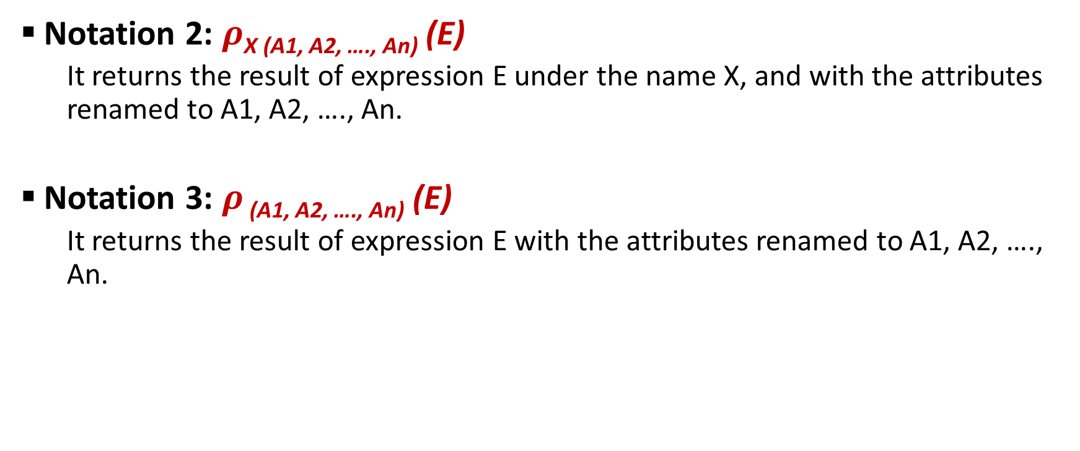
Rename Operator (Cont..)
Notation 2: $ρ$_{X (A1, A2, …., An)} (E)
It returns the result of expression E under the name X, and with the attributes renamed to A1, A2, …., An.
Notation 3: $ρ$ _{(A1, A2, …., An)} (E)
It returns the result of expression E with the attributes renamed to A1, A2, …., An.

Slide 97
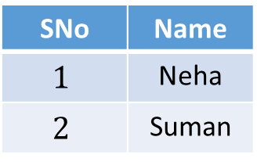
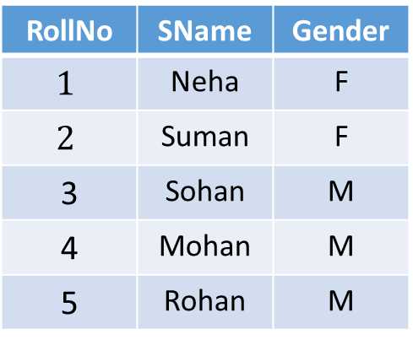
Examples:
Example-1: Query to find the female students from Student relation and rename the relation Student as FemaleStudent and the attributes of Student – RollNo as SNo, Name.
Student
RollNo | SName | Gender
$$1$$ | Neha | F
$$2$$ | Suman | F
3 | Sohan | M
4 | Mohan | M
5 | Rohan | M
FemaleStudent
SNo | Name
$$1$$ | Neha
$$2$$ | Suman
Rename
$ρ$ _{FemaleStudent(SNo, Name)} ($∏$_{RollNo,Sname} ($σ$_{gender=‘F’} (Student)))

Slide 98
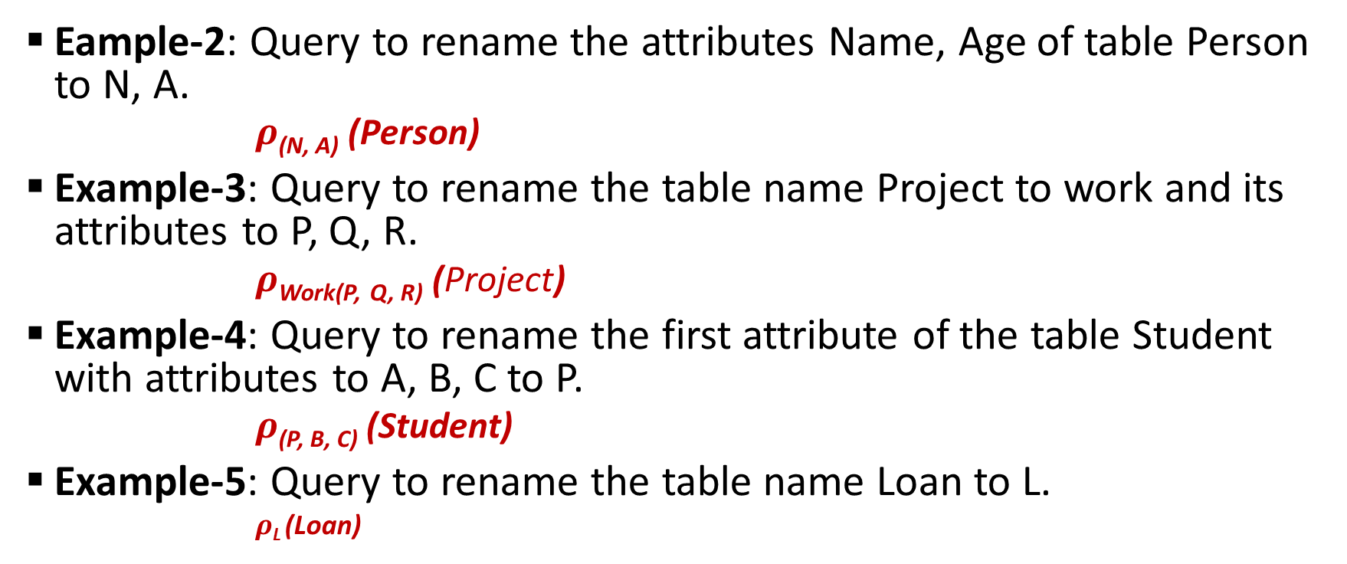
Examples:
Eample-2: Query to rename the attributes Name, Age of table Person to N, A.
$ρ$_{(N, A)} (Person)
Example-3: Query to rename the table name Project to work and its attributes to P, Q, R.
$ρ$_{Work(P,} _{Q, R)} (Project)
Example-4: Query to rename the first attribute of the table Student with attributes to A, B, C to P.
$ρ$_{(P, B, C)} (Student)
Example-5: Query to rename the table name Loan to L.
$ρ$_{L} (Loan)

Slide 99
JOIN OPERATOR & Its Type

Slide 100
Before Introduction
Cartesian product of two relation (AxB), gives us all the possible tuples that are paired together.
But it might not be feasible in certain cases to take a Cartesian product where we encounter huge relations with thousands of tuples having a considerable large number of attributes.

Slide 101
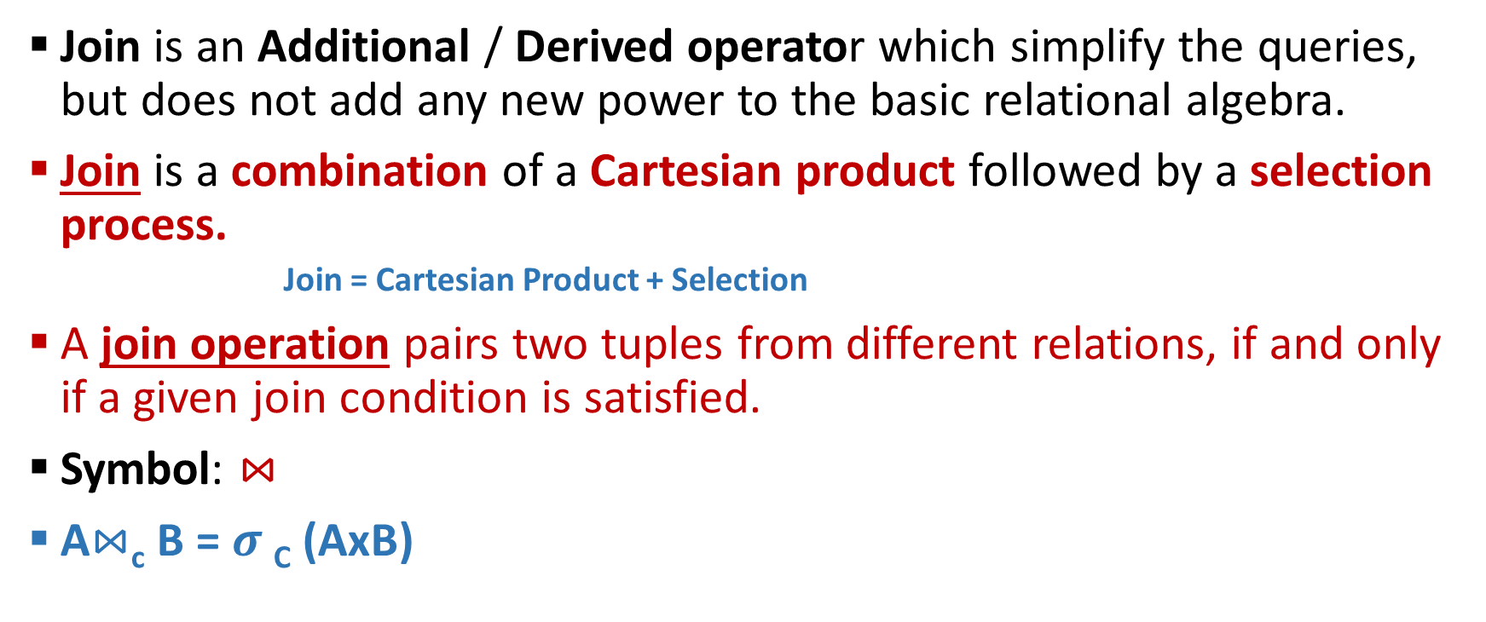

Join Operation ($⋈$)
Join is an Additional / Derived operator which simplify the queries, but does not add any new power to the basic relational algebra.
Join is a combination of a Cartesian product followed by a selection process.
Join = Cartesian Product + Selection
A join operation pairs two tuples from different relations, if and only if a given join condition is satisfied.
Symbol: $⋈$
A$⋈$_{c} B = $σ$_{C} (AxB)

Slide 102
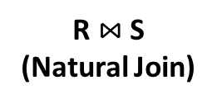

Difference
Join ($⋈$)
Cartesian Product /Cross Product/ Cross Join (X)
Combination of tuples that satisfy the filtering/matching conditions
Fewer tuples then cross product, might be able to compute efficiency.
All possible combination of tuples from the relations
Huge number of tuples and costly to manage
R
S
R x S
A | B
1 | a
2 | b
B | C
a | 3
b | 4
A | R.B | S.C | C
1 | a | a | 3
1 | a | b | 4
2 | b | a | 3
2 | b | b | 4
R $⋈$ S
(Natural Join)
A | B | C
1 | a | 3
2 | b | 4

Slide 103
Types of JOINS
Inner Join (Join):
Theta Join
Equi Join
Natural Join
Outer Join (Extension of Join):
Left Outer Join
Right Outer Join
Full Outer Join

Slide 104
Types of JOINS
Inner Join (Join):
Contains only those tuples that satisfy the matching condition
Theta Join
Equi Join
Natural Join
Outer Join (Extension of Join):
Contains matching tuples that satisfy the matching condition, along with some or all tuples that do not satisfy the matching condition
Contains all rows from either one or both relation
Left Outer Join
Right Outer Join
Full Outer Join

Slide 105
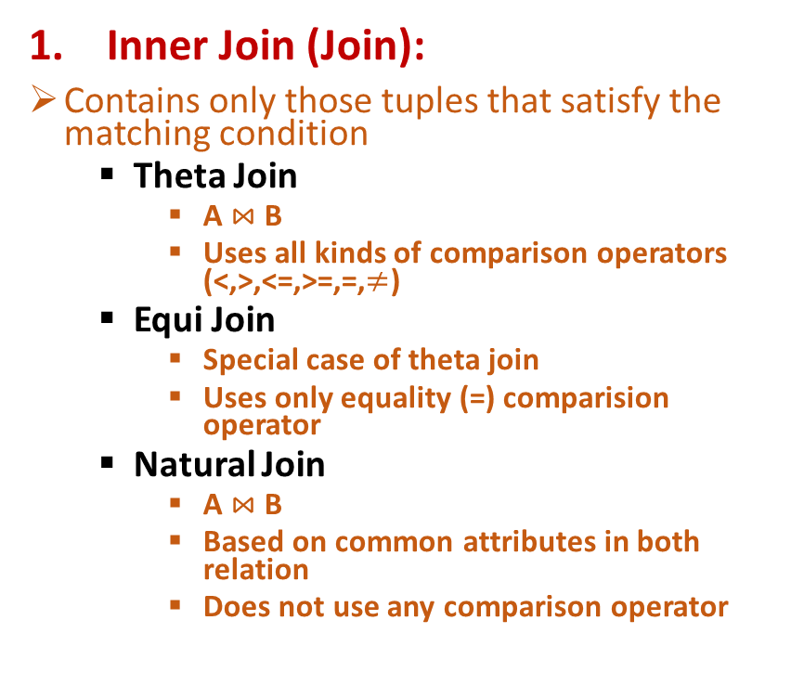
Types of JOINS
Inner Join (Join):
Contains only those tuples that satisfy the matching condition
Theta Join
A $⋈$ B
Uses all kinds of comparison operators (<,>,<=,>=,=,$≠$)
Equi Join
Special case of theta join
Uses only equality (=) comparision operator
Natural Join
A $⋈$ B
Based on common attributes in both relation
Does not use any comparison operator
Outer Join (Extension of Join):
Contains matching tuples that satisfy the matching condition, along with some or all tuples that do not satisfy the matching condition
Contains all rows from either one or both relation
Left Outer Join
Left relation tuples always be in result whether the value is matched or not
Right Outer Join
Right relation tuples will always be in result whether the value is matched or not.
Full Outer Join
Tuples from relations are present in result, whether the value is matched or not.

Slide 106
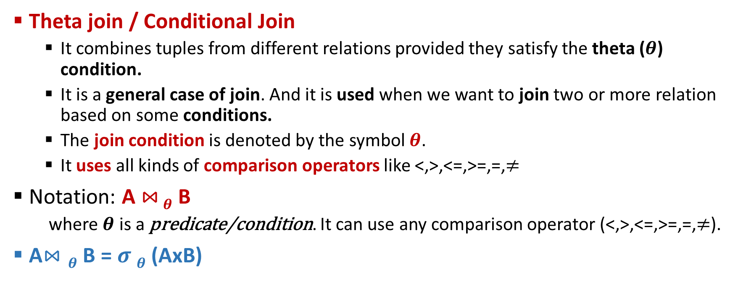

Theta ($θ$) / Conditional Join
Theta join / Conditional Join
It combines tuples from different relations provided they satisfy the theta ($θ$) condition.
It is a general case of join. And it is used when we want to join two or more relation based on some conditions.
The join condition is denoted by the symbol $θ$.
It uses all kinds of comparison operators like <,>,<=,>=,=,$≠$
Notation: A $⋈$ $θ$ B
where$θ$ is a predicate/condition. It can use any comparison operator (<,>,<=,>=,=,$≠$).
A$⋈θ$ B = $σ θ$ (AxB)

Slide 107
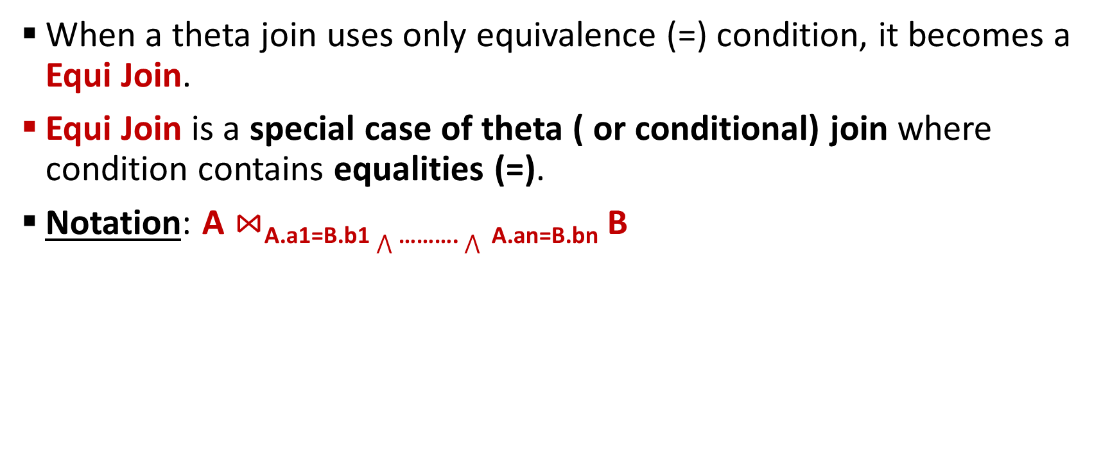
Equi Join
When a theta join uses only equivalence (=) condition, it becomes a Equi Join.
Equi Join is a special case of theta ( or conditional) join where condition contains equalities (=).
Notation: A $⋈$_{A.a1=B.b1} $⋀$ ………. $⋀$ _{A.an=B.bn} B

Slide 108
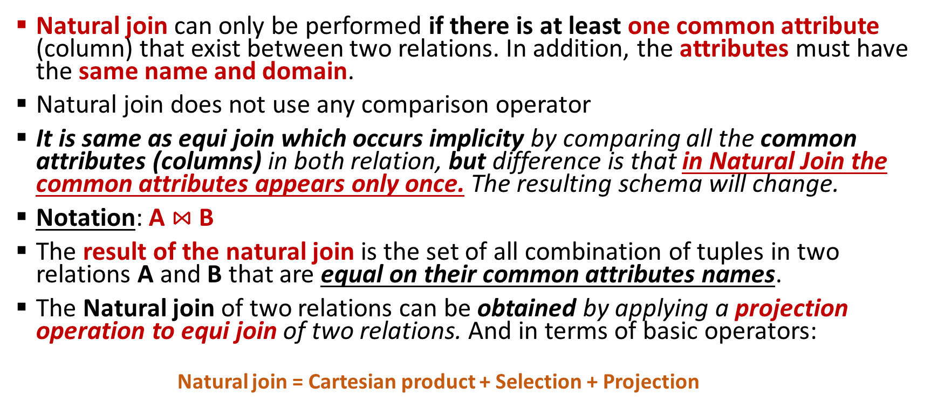
Natural Join
Natural join can only be performed if there is at least one common attribute (column) that exist between two relations. In addition, the attributes must have the same name and domain.
Natural join does not use any comparison operator
It is same as equi join which occurs implicity by comparing all the common attributes (columns) in both relation, but difference is that in Natural Join the common attributes appears only once. The resulting schema will change.
Notation: A $⋈$ B
The result of the natural join is the set of all combination of tuples in two relations A and B that are equal on their common attributes names.
The Natural join of two relations can be obtained by applying a projection operation to equi join of two relations. And in terms of basic operators:
Natural join = Cartesian product + Selection + Projection

Slide 109
Outer Join
An Inner join includes only those tuples with matching attributes and the rest are discarded in the resulting relation. Therefore, we need to use outer joins to include all the rest of the tuples form the participating relations in the resulting relation.
The outer join operation is an extension of the join operation that avoids loss of information.
Outer join contains matching tuples that satisfy the matching condition, along with some or all tuples that do not satisfy the matching condition.
It is based on both matched or unmatched tuple.
It contains all rows from either one or both relations are present
It uses NULL values.
NULL signifies that the value is unknown or does not exist.
Outer Join = Natural Join + Extra Information

Slide 110
Q&A

Slide 111
Thank You !!!

